Slide 1


<Shaowen Feng>
<June 09 2025>

Slide 2

Outline
Executive Summary
Introduction
Methodology
Results
Conclusion
Appendix

Slide 3
Executive Summary
Summary of methodologies
Data Collection
Data Wrangling
Exploratory Data Analysis
Interactive Data Visualization
Predictive Model Building
Summary of Results
Best model chosen: Decision Tree model
Model performance: Accuracy score: 87.7%

Slide 4
Introduction
Project background and context
SpaceX advertised Falcon 9 rocket launches with a much less cost than other providers because it can reuse the first stage. In order to determine the cost of each launch, we need to determine if the first stage will land successfully.
Problems I want to find answers
What factors affect the successful landing rate?
How do I gather the necessary information?
What method should I choose to analyze the data?
How do I present the findings to my audience?
What model should I choose to predict the outcome of landing?

Slide 5

Section 1

Slide 6
Methodology
Executive Summary
Data collection methodology:
Making a get request to the SpaceX API
Performing web scraping to collect Falcon 9 historical launch data from a Wikipedia page
Perform data wrangling
Creating a Class variable to convert outcome into training label with 1 as success and 0 as failure
Perform exploratory data analysis (EDA) using visualization and SQL
Perform interactive visual analytics using Folium and Plotly Dash
Perform predictive analysis using classification models
Create a cross-validation object finding the best hyperparameters for the following classfication models: SVM, classification trees, Logistic Regression and KNN

Slide 7
Data Collection
Method 1: Collecting SpaceX Falcon 9 Launch data by SpaceX API request with the following URL: “https://api.spacexdata.com/v4/launches/past”
Method 2: Collecting SpaceX Falcon 9 Launch data by web scraping process from Wikipedia page with the title “List of Falcon 9 and Falcon Heavy launches” https://en.wikipedia.org/wiki/List_of_Falcon_9_and_Falcon_Heavy_launches

Slide 8
Data Collection – SpaceX API
Key data collection phrases
Request the SpaceX launch data using the GET request and convert it to a data frame
Take a subset of the original data frame keeping only the necessary features
Use a series of of helper functions to parse information using ID numbers in the launch data
Filter the data frame to only include the Falcon 9 launches data
Here is the GitHub URL of the completed SpaceX API calls notebook: https://github.com/Mimicorn/Space-Repo/blob/main/notebooks/jupyter-labs-spacex-data-collection-api.ipynb

Slide 9
Data Collection – SpaceX API
FlowChart of SpaceX API calls
Export the data frame to a csv file
Request rocket launch data from SpaceX API
Filter the data frame to include the Falcon 9 launches only: data[data['BoosterVersion']!='Falcon 1']
Convert launch data to a data frame called data
Convert the dictionary to the data frame
Take a subset of data
data[['rocket', 'payloads', 'launchpad', 'cores', 'flight_number', 'date_utc']]
Create a dictionary to store all the data from the global lists
Convert the date_utc to the datetime data type and extract the date only
Apply the helper functions to the data frame
Define Four helper functions: getBoosterVersion(), getLaunchSite(), getPayloadData(), getCoreData()
Create the global list variables to store extracted data individually by each helper function

Slide 10
Data Collection - Scraping
Key data collection phrases by web scraping
Request Falcon 9 launch HTML page
Web scrape Falcon 9 launches data with BeautifulSoup
Extract a Falcon9 launch records HTML table from Wikipedia
Parse the table and convert it to a Pandas data frame
Here is GitHub URL of the completed web scraping notebook: https://github.com/Mimicorn/Space-Repo/blob/main/notebooks/jupyter-labs-webscraping.ipynb
Create a BeautifulSoup object from the HTML response
Extract all column names from the HTML table header
Create a data frame by parsing the launch HTML tables
Export the data frame to a csv file

Slide 11
Data Wrangling
Key phrases of data wrangling process
Flow chart of converting outcomes into training class
Replace missing value with the mean
Convert outcomes into training class labels
Here is the GitHub URL of my completed data wrangling related notebooks: https://github.com/Mimicorn/Space-Repo/blob/main/notebooks/labs-jupyter-spacex-Data%20wrangling.ipynb
Load SpaceX dataset from collection phrase
Calculate the number of landing outcomes
Create a set of outcomes the first stage did not land successfully
Create a list landing_class to distinguish whether the first stage landed successfully or not
Convert the landing_class list into a new data frame column Class

Slide 12
EDA with Data Visualization
Scatter plot of the FlightNumber vs. PayloadMass to indicate how they affect the launch outcome
Scatter chart of the FlightNumber vs. Launch Site to visualize how they affect the launch outcome
Scatter chart of the Payload Mass vs. Launch Site to indicate how they affect the launch outcome
Bar chart for the success rate of each orbit site
Scatter plot of the FlightNumber vs. Orbit to visualize how they affect the launch outcome
Scatter chart of the Payload Mass vs. Orbit to indicate how they affect the launch outcome
Line chart of the success rate over years trend
This is the GitHub URL of my completed EDA with data visualization notebook:
https://github.com/Mimicorn/Space-Repo/blob/main/notebooks/edadataviz.ipynb

Slide 13
EDA with SQL
Display the names of the unique launch sites in the space mission
Display five records where launch sites begin with the string “CCA”
Display the total payload mass carried by boosters launched by NASA (CRS)
Display average payload mass carried by booster version F9 v1.1
List the date when the first succesful landing outcome in ground pad was acheived
List the names of the boosters which have success in drone ship and have payload mass greater than 4000 but less than 6000
List the total number of successful and failure mission outcomes
List all the booster_versions that have carried the maximum payload mass
List the records which will display the month names, failure landing_outcomes in drone ship ,booster versions, launch_site for the months in year 2015
Rank the count of landing outcomes between the date 2010-06-04 and 2017-03-20, in descending order
Here is the GitHub URL of my completed EDA with SQL notebook: https://github.com/Mimicorn/Space-Repo/blob/main/notebooks/jupyter-labs-eda-sql-coursera_sqllite.ipynb

Slide 14
Build an Interactive Map with Folium
Create an orange circle using folium.Circle to highlight NASA Johnson Space Center and add a marker object as a popup label showing its name
Generate circles to highlight each SpaceX launch site and add markers as popup labels for them
Create a marker cluster object to simplify a map containing many markers at the same coordinate
Create marker object for each launch to indicate if the launch was successful or failed
Add a mouse position object to get coordinate for a mouse over a point on the map
Create a polyline object to draw a line between a launch site and a selected point
Add a distance marker to indicate the distance between a launch site and a selected point
Here is the GitHub URL of my completed interactive map with Folium map: https://github.com/Mimicorn/Space-Repo/blob/main/notebooks/lab_jupyter_launch_site_location.ipynb

Slide 15
Build a Dashboard with Plotly Dash
Create an interactive pie chart to visualize the successful launch rates both among all the launch sites and for a specific launch site
Create an interactive scatter chart to indicate the correlation between Payload Mass and success for all launch sites or the choosing launch site
Here is the GitHub URL of my completed Plotly Dash lab: https://github.com/Mimicorn/Space-Repo/blob/main/python/spacex_dash_app.py

Slide 16
Predictive Analysis (Classification)
Key phrases of model development
Flow chart of model development
Create a column for the class y
Standardize the data X
Split the data into training set and testing set
Create a cross-validation GridSearchCV object for different machine learning models
Fit the GridSearchCV object with the training data and find the best hyperparameters and the accuracy score for each model
Compare the accuracy score among the four classification models and find the best one
Load the dataset and convert to a data frame
Create Y from the column Class
Standardize X
Split X and Y into training and testing set
Create GridSearchCV for four models
Find the best hyperparameters and accuracy scores for each model
Find the best score among the models
Here is the GitHub URL of my completed predictive analysis lab: https://github.com/Mimicorn/Space-Repo/blob/main/notebooks/SpaceX_Machine%20Learning%20Prediction_Part_5.ipynb

Slide 17
Results
Exploratory data analysis results
Interactive analytics demo in screenshots
Predictive analysis results

Slide 18

Section 2

Slide 19
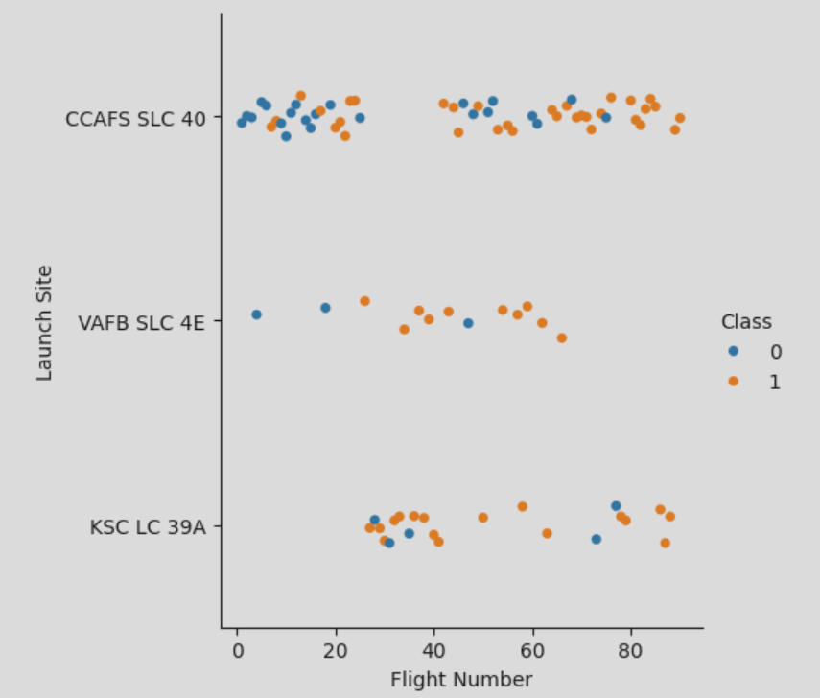
Flight Number vs. Launch Site
Scatter plot of Flight Number vs. Launch Site with Class value 1 as a successful landing and 0 as a failed landing

Slide 20
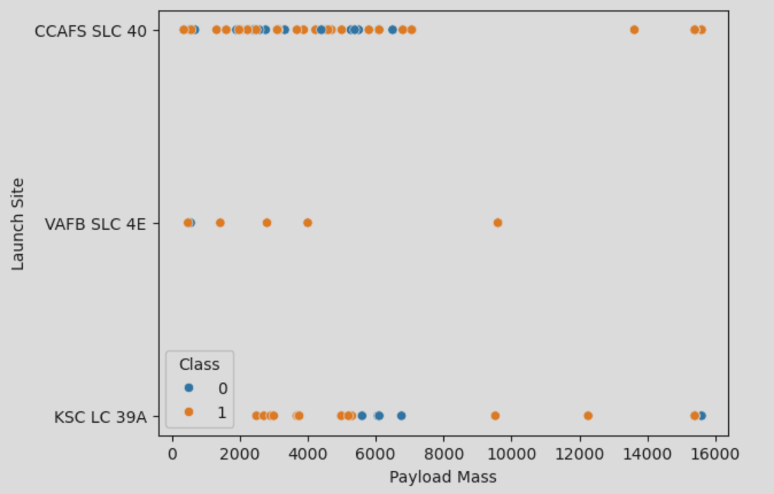
Payload vs. Launch Site
Scatter plot of Payload vs. Launch Site with Class value 1 indicating a successful landing and 0 indicating a failed landing

Slide 21
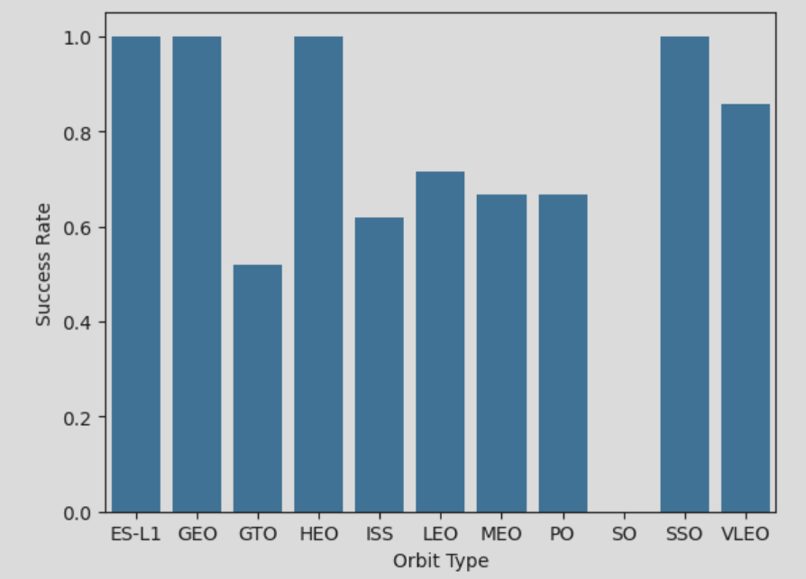
Success Rate vs. Orbit Type
Bar chart visualizing the relationship between success rate of each orbit type

Slide 22
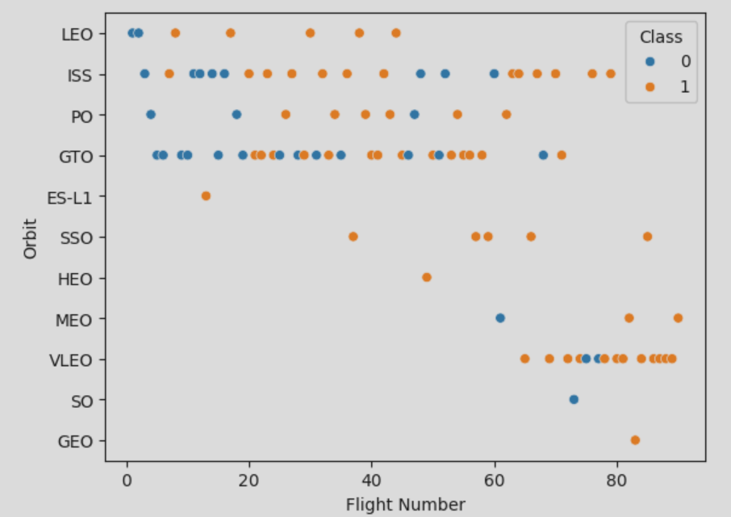
Flight Number vs. Orbit Type
Scatter chart to visualize the relationship between Flight number and Orbit type

Slide 23
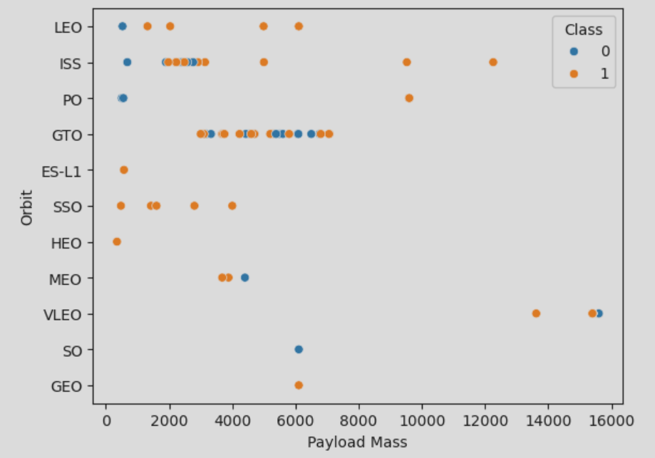
Payload vs. Orbit Type
Scatter point chart indicating the relationship between Payload Mass and Orbit type

Slide 24
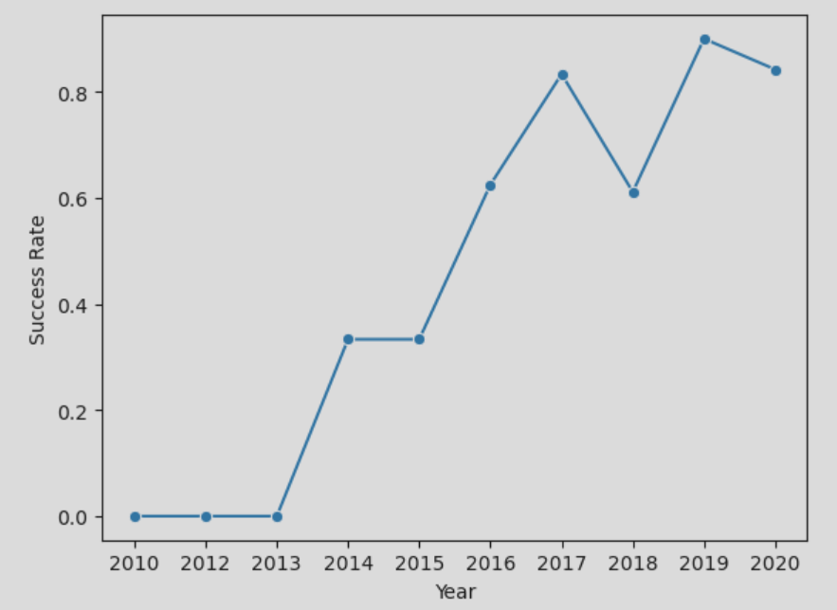
Launch Success Yearly Trend
Line chart of yearly average success rate trend

Slide 25
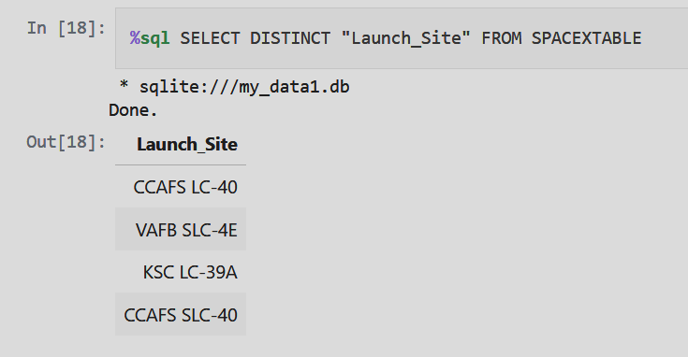
All Launch Site Names
Find the names of the unique launch sites using DISTINCT keyword

Slide 26
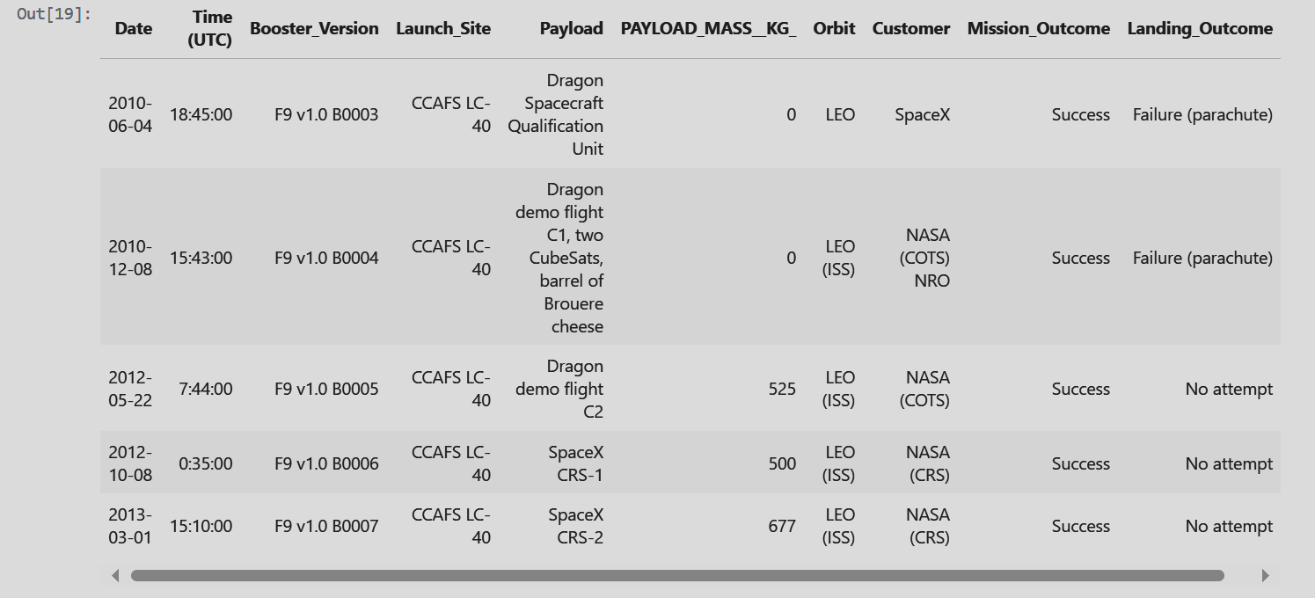
Launch Site Names Begin with 'CCA'
Five records where launch sites begin with `CCA`

Slide 27
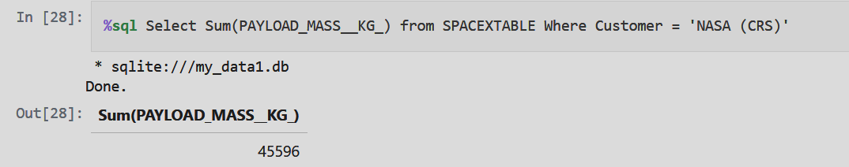
Total Payload Mass
The total payload carried by boosters from NASA using SUM() function

Slide 28
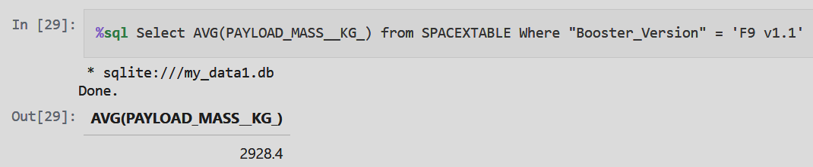
Average Payload Mass by F9 v1.1
Calculate the average payload mass carried by booster version F9 v1.1 using AVG() function

Slide 29
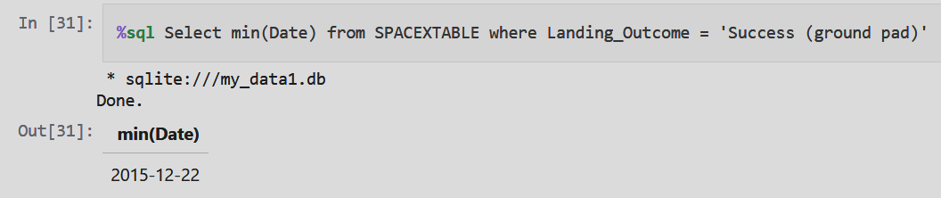
First Successful Ground Landing Date
Find the dates of the first successful landing outcome on ground pad by MIN() function

Slide 30
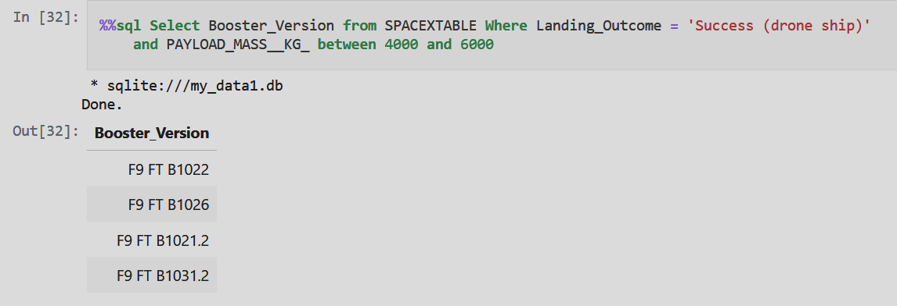
Successful Drone Ship Landing with Payload between 4000 and 6000
List the names of boosters which have successfully landed on drone ship and had payload mass greater than 4000 but less than 6000

Slide 31
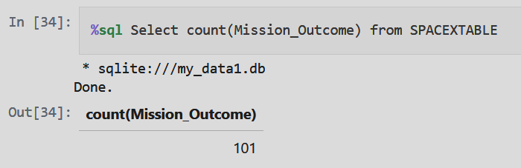
Total Number of Successful and Failure Mission Outcomes
Calculate the total number of successful and failure mission outcome

Slide 32
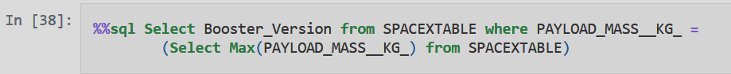
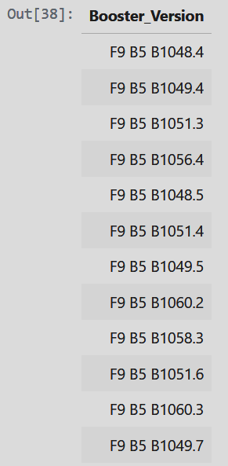
Boosters Carried Maximum Payload
List the names of the booster which have carried the maximum payload mass

Slide 33
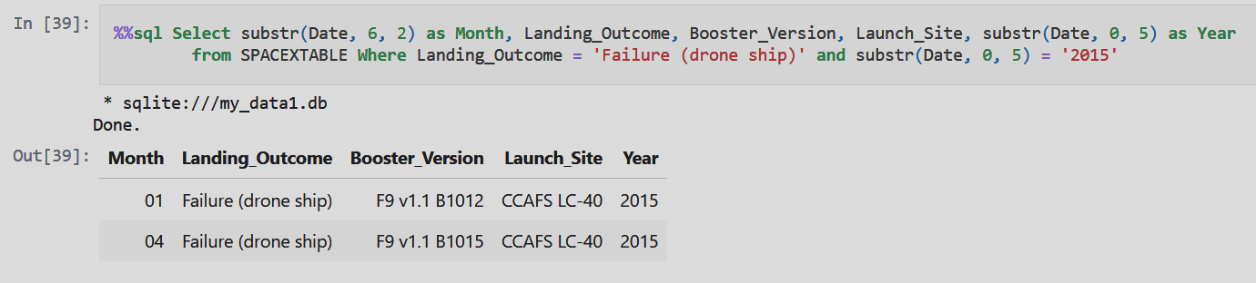
2015 Launch Records
List the failed landing_outcomes in drone ship, their booster versions, and launch site names for year 2015

Slide 34
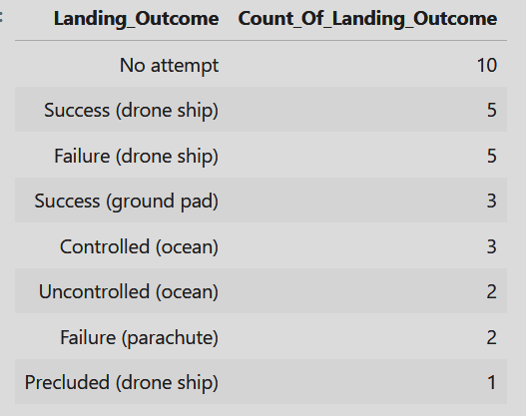
Rank Landing Outcomes Between 2010-06-04 and 2017-03-20
Rank the count of landing outcomes (such as Failure (drone ship) or Success (ground pad)) between the date 2010-06-04 and 2017-03-20, in descending order
SQL query:
Select Landing_Outcome, count(*) as Count_Of_Landing_Outcome from SPACEXTABLE Where Date between '2010-06-04' and '2017-03-20' Group by Landing_Outcome Order by Count_Of_Landing_Outcome Desc
Output result:

Slide 35

Section 3

Slide 36
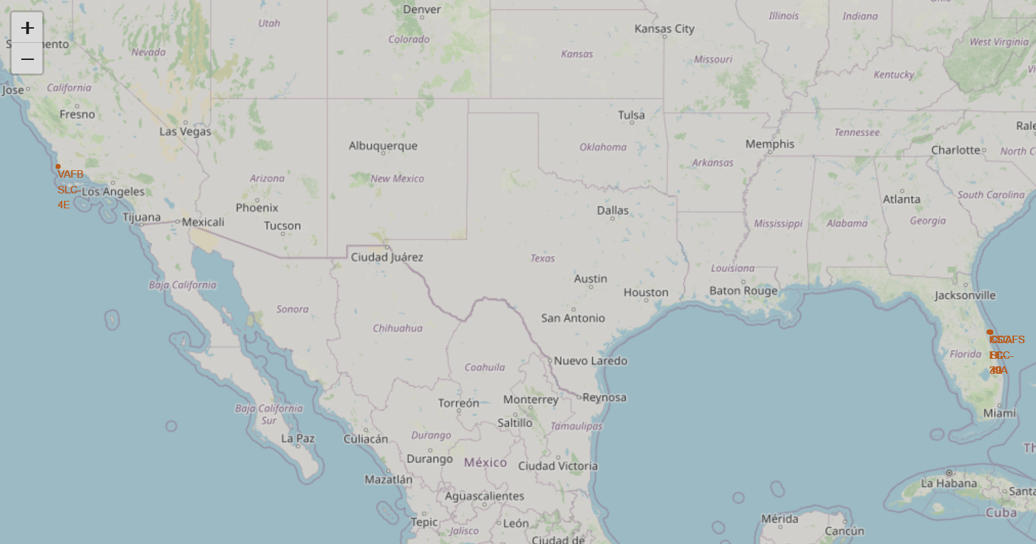
All Launch Sites Folium Map
The screenshot shows totally four launch sites are marked on a Folium map with three sites located close to each other in Florida

Slide 37
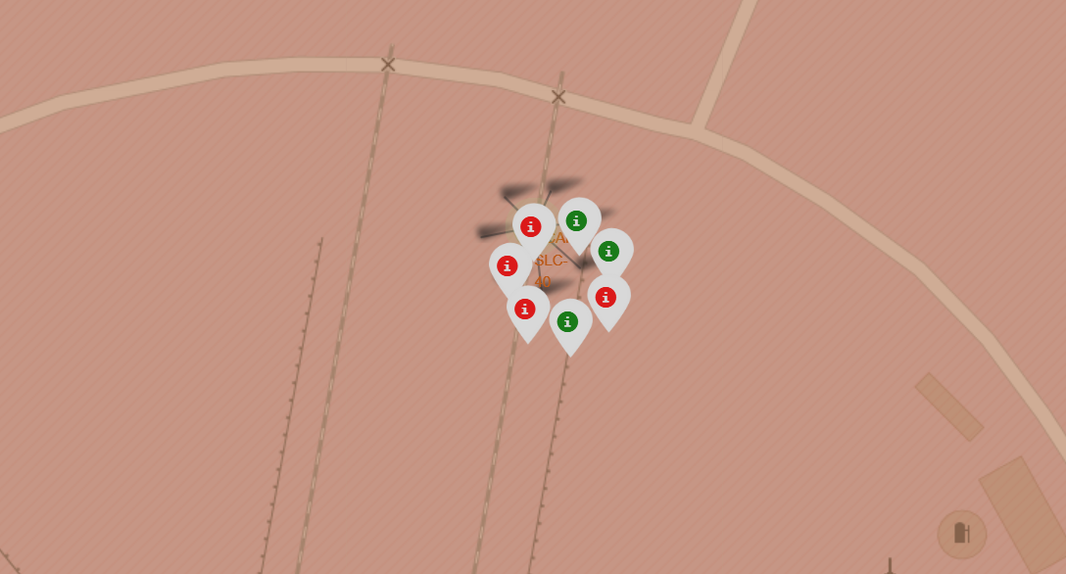
The Successful/Failed Launches for CCAFS SLC-40 on the Map
The following screenshot shows 3 successful launches (green) and 4 failed launches (red) for the site of CCAFS SLC-40 by marker cluster

Slide 38
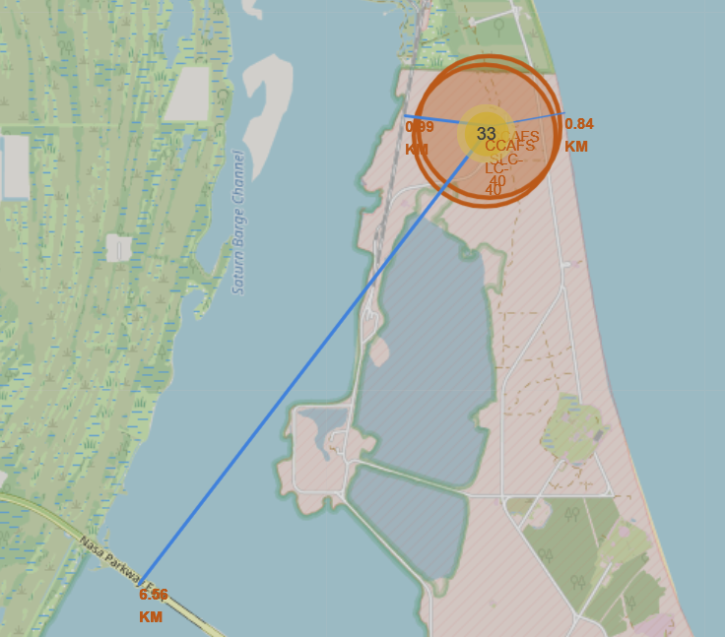
The Launch Site CCAFS SLC-40 to its Proximities on the Map
The screenshot shows the launch site CCAFS SLC-40 to its proximities such as railway, highway, coastline, with distance calculated and displayed by Folium.Polyline and Folium.Marker

Slide 39

Section 4

Slide 40
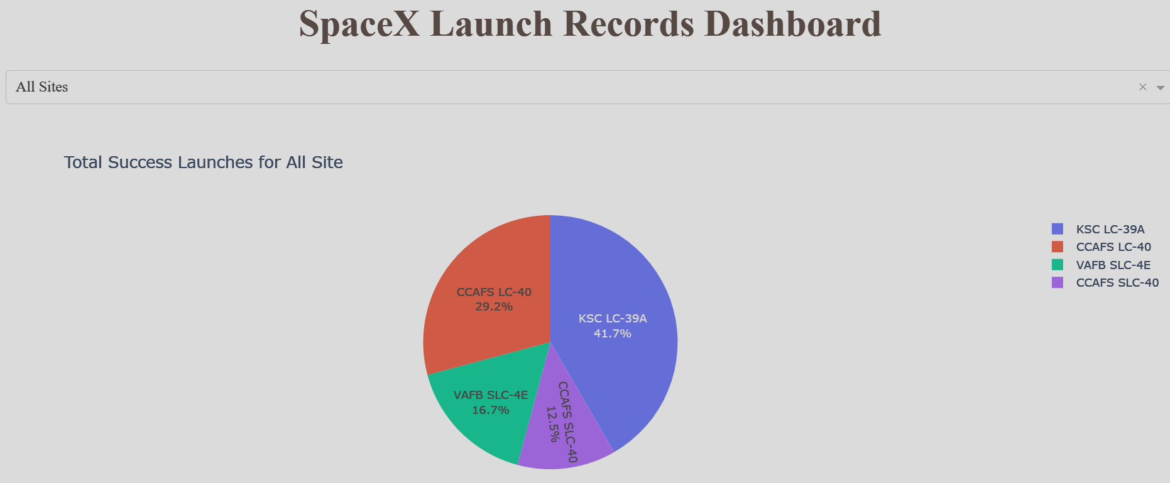
Pie Chart of Total Successful Rates for All Launch Sites
The screenshot indicates the launch success rates for all four sites in a pie chart. The launch site can be chosen from the dropdown object.

Slide 41
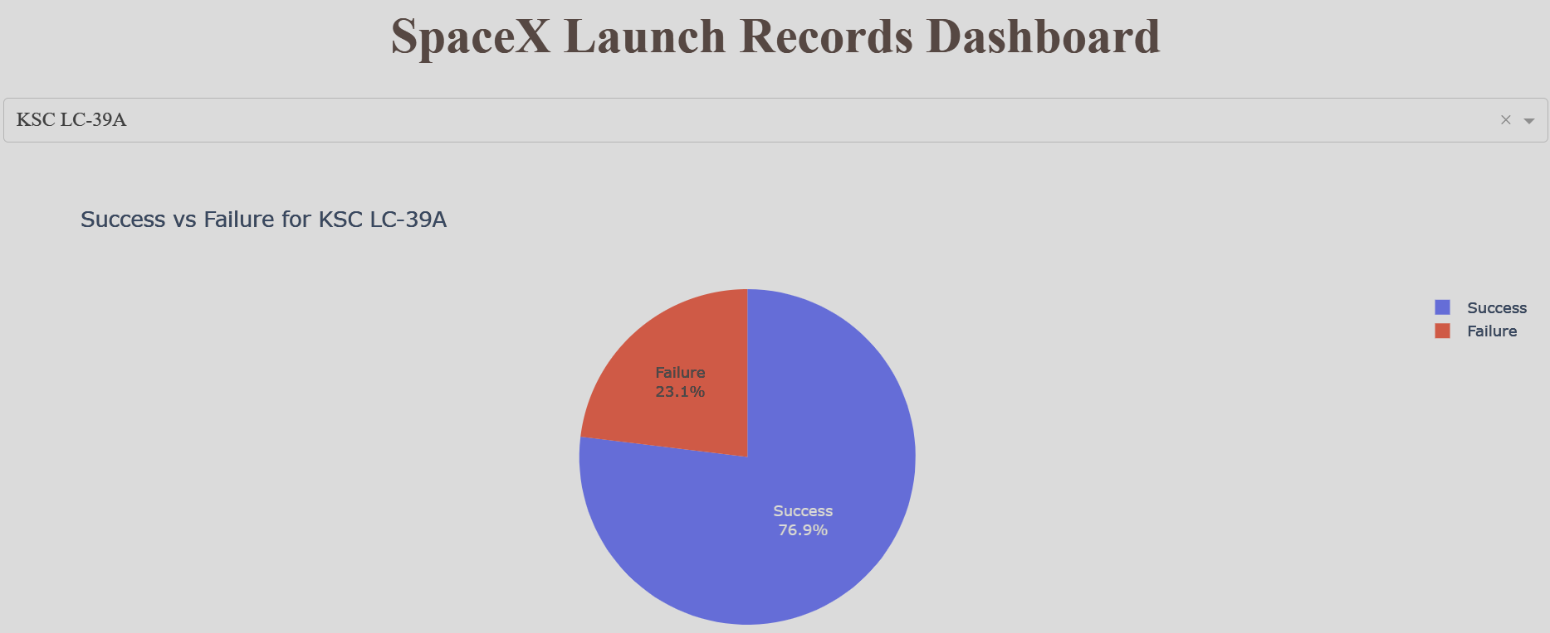
Pie Chart of the Launch Site with the Highest Launch Success Ratio
The screenshot indicates KSC LC-39A with the highest launch success ratio. The launch site can be chosen from the dropdown object.

Slide 42
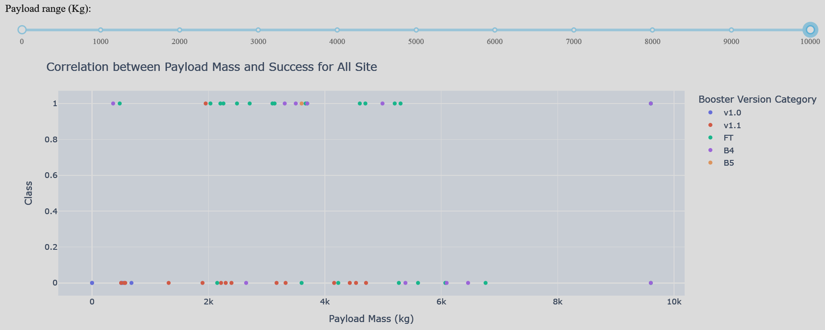
Scatter Plot of Payload vs. Launch Outcome for All Sites
The screenshot indicates the correlation between the Payload and launch Outcome for all sites with color points to distinguish different booster versions. The range slider is used to choose the range of the payload mass. The booster version FT has the highest success rate for the payload range from 0kg to 100000kg.

Slide 43

Section 5

Slide 44
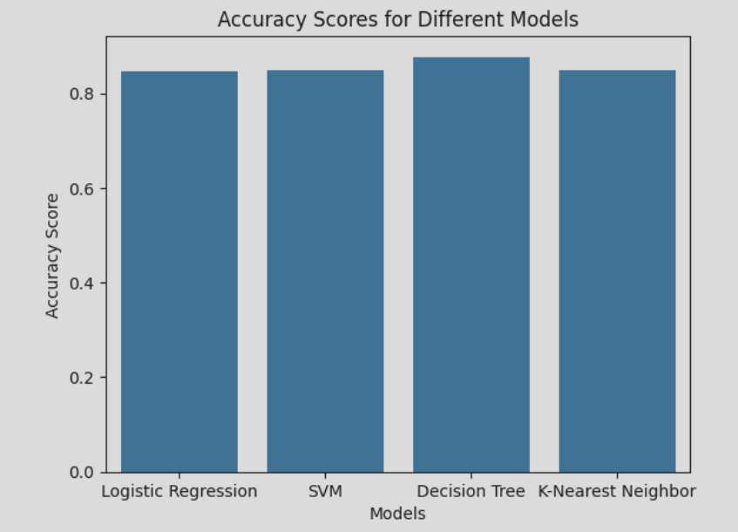
Classification Accuracy
The screenshot is a bar chart to visualize the built model accuracy for all built classification models
From the bar chart, we can tell the Decision Tree model has the highest accuracy score.

Slide 45
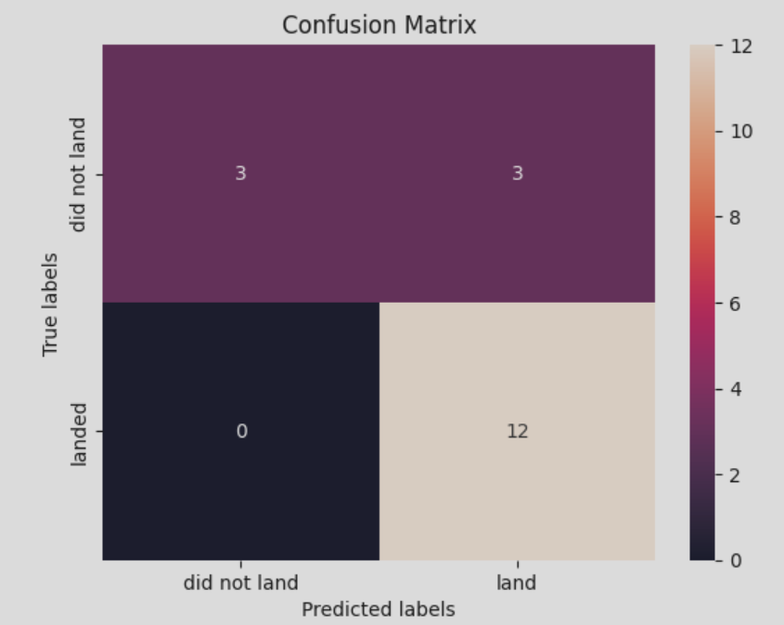
Confusion Matrix
Confusion matrix of the best performing model: Decision Tree model
True Positive: 12
False Positive: 3
True Negative: 0
False Negative: 3

Slide 46
Conclusions
The best performing model is decision tree model
The accuracy score of the decision tree model is 0.8768
Precision for successful landing outcome is 0.8 (12/(12+3)=0.8)
Recall for successful landing outcome is 0.8 (12/(12+3)=0.8)

Slide 47
Appendix
Dataset csv Files:
https://github.com/Mimicorn/Space-Repo/blob/main/data/Spacex.csv
https://github.com/Mimicorn/Space-Repo/blob/main/data/dataset_part_1.csv
https://github.com/Mimicorn/Space-Repo/blob/main/data/dataset_part_2.csv
https://github.com/Mimicorn/Space-Repo/blob/main/data/dataset_part_3.csv
https://github.com/Mimicorn/Space-Repo/blob/main/data/spacex_launch_dash.csv
https://github.com/Mimicorn/Space-Repo/blob/main/data/spacex_web_scraped.csv
Jupyter Notebooks:
https://github.com/Mimicorn/Space-Repo/tree/main/notebooks
Python Files:
https://github.com/Mimicorn/Space-Repo/blob/main/python/spacex_dash_app.py

Slide 48


